Slide 1
How 21st Century Humanity Will Be Remembered
Preserving Your Story
A Self-Portrait for the Future
Your Personality Remains
Codex of Humanity
The Memory Bank
Your Life Is Worth Saving

Slide 2
Vision Statement
For Humanity
For You
Allow the real you to be remembered forever—share your passions, wisdom and experiences with posterity
Permanently preserve 21st century experiences as the inception of Earth’s Library of Humanity in the metaverse

Slide 3
Mission Statement
MyLife.org is how humans of the 21st Century will be remembered for posterity.
MyLife.org is committed to providing humanity a durable, enduring and free internet-based platform to collect and showcase an individual’s stories, media, and memories through a personal lens.
A MyLife.org memorial will always be free and available to all, where loved ones, friends and visitors can share in your experiences and leave behind personalized memory tributes in this living, evolving, everlasting encyclopedia of our selves.
Be remembered.
We are an enduring, self-directed living trust for an individual’s personality remains

Slide 4
What Is MyLife?
MyLife: A Digital Platform to Tell Your Story
Easy-to-use input methods
Interactive narrative engines
Direct connections to popular content engines
Facebook, Ancestry, imdb, etc.
Peer Interactions
Gamified, social circle, relatives, stranger-on-a-bus, etc.
Real-Time event capture
Intuitive curation mechanics
Automated curation hints from metadata
Flexible content organization
Varied and accessible search and editing tools, such as “Reliving Memories”
MyLife: Experience Past Humanity
Sensible, respectful and serious design
Uniform and consistent user experience
Browsable from a great many facets
Individual, Topic (hobby, interest, ailment), Region, Belief, etc.
Leave personal memories of deceased
Dynamic and evolving platform

Slide 5
Why Do It?
For You
Express yourself to posterity
Experience profound self-reflection and personal growth
Preserve and share the lessons and meaning of your life
Easy reference to your history while living it
Therapeutic
A guarantee to be seen by others
Assurance to endure beyond your lifetime
Easy-to-use—no need to be a technical or creative genius to be remembered as the unique self that you are
AIand Template-assistance for introspection
*** Compare with curation request to LinkedIn: Articulate the inherent value (as competitive with career)
Gamification for digital natives?
For Humanity
Evolution of the mind and consciousness
Foster and encourage global empathy
Comprehensive and accessible memory of itself
Evolving and durable virtual home
Proven emergent technologies for self-expression become assimilated into the platform
Geri, Chatbots, Wearables, Mini-Me, etc.

Slide 6
Values and Principles
All contributions of self are accepted
No censors, information moderators
Cannot censor material (possibly access, as required)
(Data) Dignity, right and equality of every human
Consent-focused
Right to show
Right to be seen/not seen
No barrier to entry
Free
Ubiquitous
Accessible
Encourage Authenticity
Radical honesty/authenticity
Modern digital trails (money, internet usage, etc) are far more revealing than MyLife, yet still; a lie is a beacon in a sea of truths
Transparency in the pursuit of one’s identity
You’re only fooling yourself
Organizational “Radical” Transparency
Interconnected Humanity is a Better Humanity
More empathetic
More introspective
Shared experiences and history
Protect personal security of information
Hacking, Access, Traceability, etc.

Slide 7
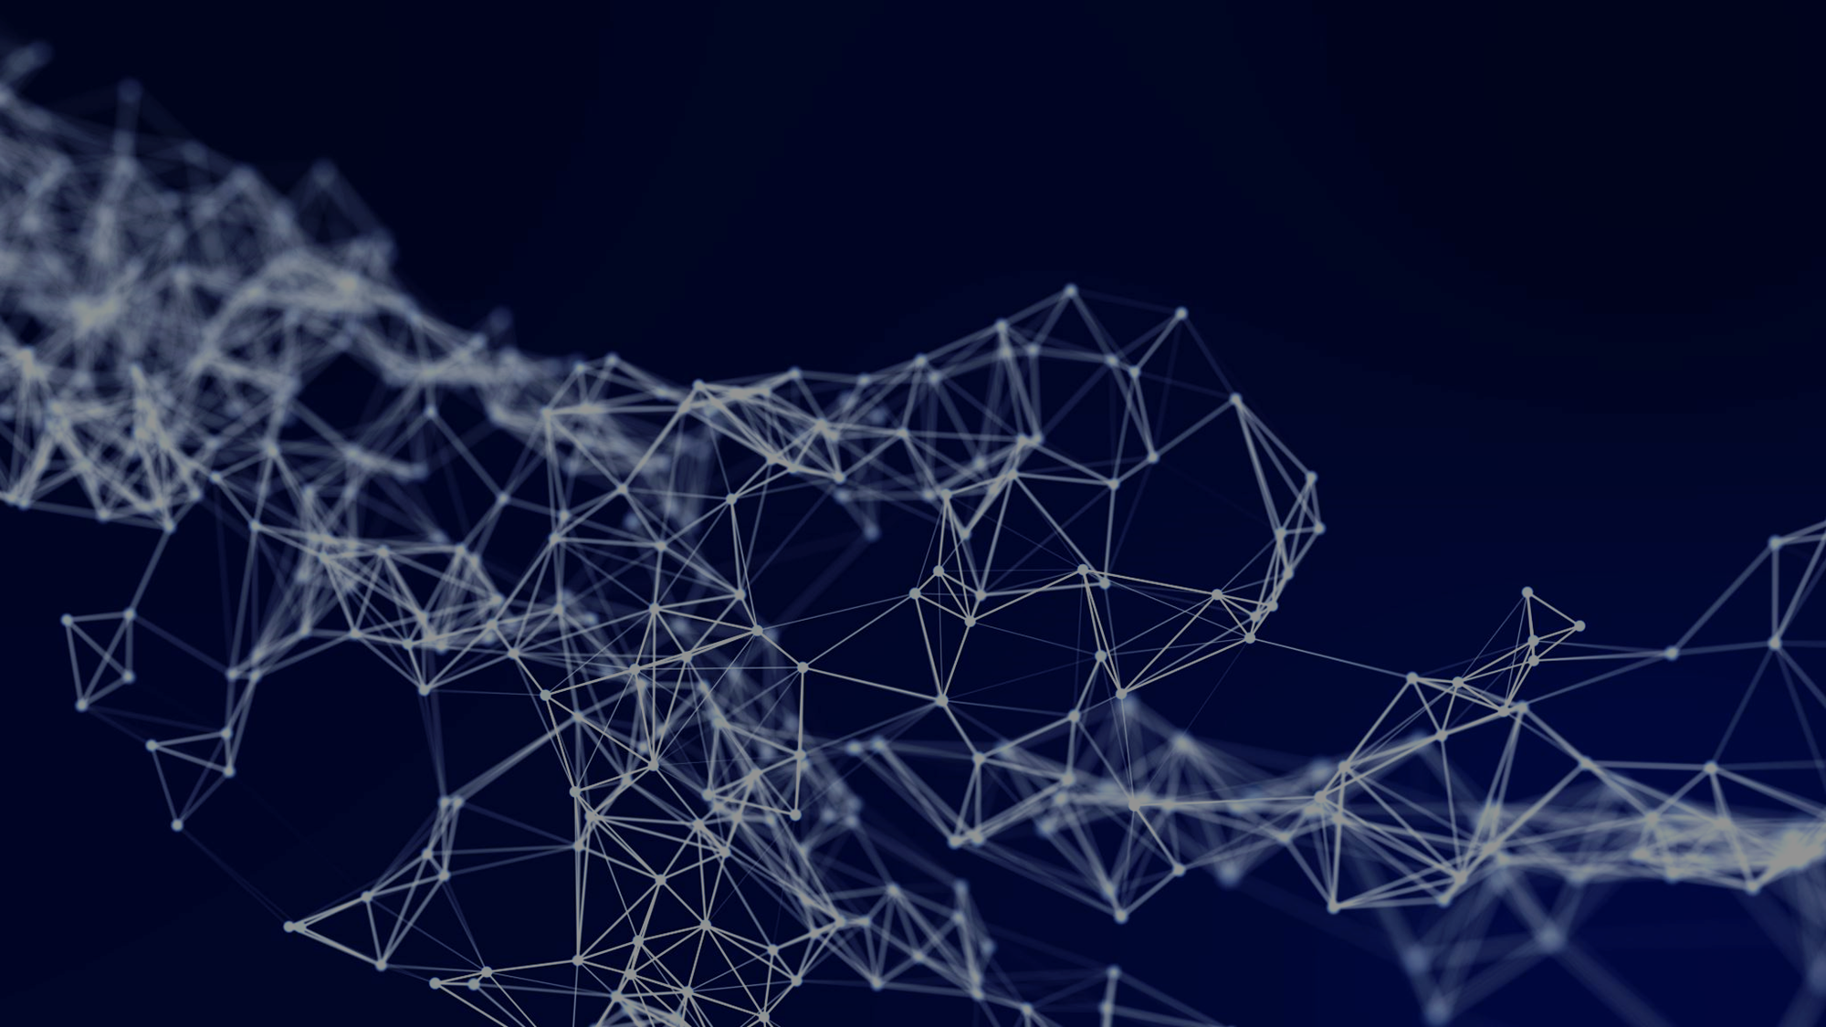
Critical Key: Personal and personal state data
External HRP Ecosystem
Separate plan for non-?
Internal MyLife Environment
git/
npm
AI-Agent
System Agent
AI-Agents sniff for macro-trends in malfeasance and irregular app usage patterns, et al.
External HRP Ecosystem Application
Request:
EcoSystem Agent
System Agent
EcoSystem DB
Authenticate
App
Subject to API Gateway Rules
MyLife
API Service
If recognized and passes partner security challenges, load into event memory: oPrivileges, variable for duration of request to assist validation
AI-Agent
System Agent
AI-Agent
System Agent
Request
Request AI-Agent
Validate request based on oPrivileges
And possibly an early sniff at user’s relation with app
Run certain validation agents in parallel that can be
Response
MyLife
Session
Session AI-Agent
Validate and create or warm/open session-identified datasets
Build and Validate Response
User
Member (data) Agent
System Agent
Mongo-saved state package
In complex procedures and remote functions, validate response will get complicated and run through a number of events and agents
MyLife
Remote Access Layer
AI-Agent
System Agent
Member AI-Agents sniff for data requests and potential manipulations (like redundant ; also manages access to data pools (own app, personal MyLife bio, other apps) – i.e., who’s askin’?!
Notes:
Critical Key: for HRP-ecosystem apps, MyLife holds Personal and personal state data
How one wishes (and becomes able) to integrate this information into MyLife will be the fun expanding challenge both for us, AI and the membership
I guess we also require an openAPI display agent to be
The apps may/must(?) keep a state-history of the [blockchain]
MyLife must keep a state-history of modifications to the JSON-DATA versioning
Actions
Authenticate [occurs each receipt]
Internal event handlers: Opens or heats associated information sets
App: opens or heats known app data upon request receipt
Authorize: Map against Rights, privileges and request limits
User indicated (pre-sniff?) has not blocked or altered permissions for application; may end up being a decoration later, I guess it depends on how often it happens and whether or not we should support early intervention; certainly we should scalably ALLOW for it
Request Metadata:
Ensures that form and content is valid according to latest JSON
Meets limits for fields (and user?)
User must have data OR user must be logged in and authenticated your app (outside ecosystem)
Session: Identifies valid session which may or may not load data about multiple users (unlikely day one!), or is merely a security gateway
User: Confirms and provides access to user data
Personal
App-Specific Record (limit always of one?)
Populate (pull request) – we diff your data then consume (git!)
Retrieve member state packet
Diff data structure of packet against git (cached within…?)
Do NOT send any field data that is not in the current JSON git/npm template (or recognized by additionally condoned rules, or AI-Agent(?))
Post
Retire/Refactor -> may need to be completed internally if ecosystem partner dissolves
May be pathway for HRP, not sure what to enforce for others, but even longer-term concern
Topic for discussion: For ecosystem apps, we should probably require that the user be “logged in” at first, but what about externals? Is it better for us if they save state instead? Don’t think so, but in such case; conceive of MyLife as a bridge instead of a data repo – i.e., MyLife, or, we the people, have access to our data wherever it resides!
It’s your data, they say! but what does that really mean right now, as each corp greedily hordes? No, THIS is how we assure and confirm that it is indeed your data
At first, a member might use company A over company B because they pay MyLife for more commits [save state] and therefore have greater potential future fidelity– this concept would atrophy (hopefully soon!) and the “apps” or digital arenas in which one spends most of the time will become the ones that save state most frequently, kind of like someone we know… consciousness
The rich will have to go first unless you want to go down in future history as fomenting a literal revolution and offing with their heads! Not a nice look either, I’m afraid! But contact with me with ideas! The non-violenter the more actionable.

Slide 8
experienceEnd() [external initiation]
frontend
routes
session
avatar
factory
dataservices
datamanager
.onClick()
experienceEnd(:eid)
experienceEnd(:eid)
Try/catch wrapper
Locks experience
experienceEnd(:eid)
Validates request
Push to #livedExperieces
Save logic
saveExperience(experience)
Validates request
Map experience
Save logic
saveExperience(experience)
pushItem()
pushItem(experience)
Saves to database
Returns experience object
Notes:
Sequence Diagram
Eid = experienced (experience.id)

Slide 9
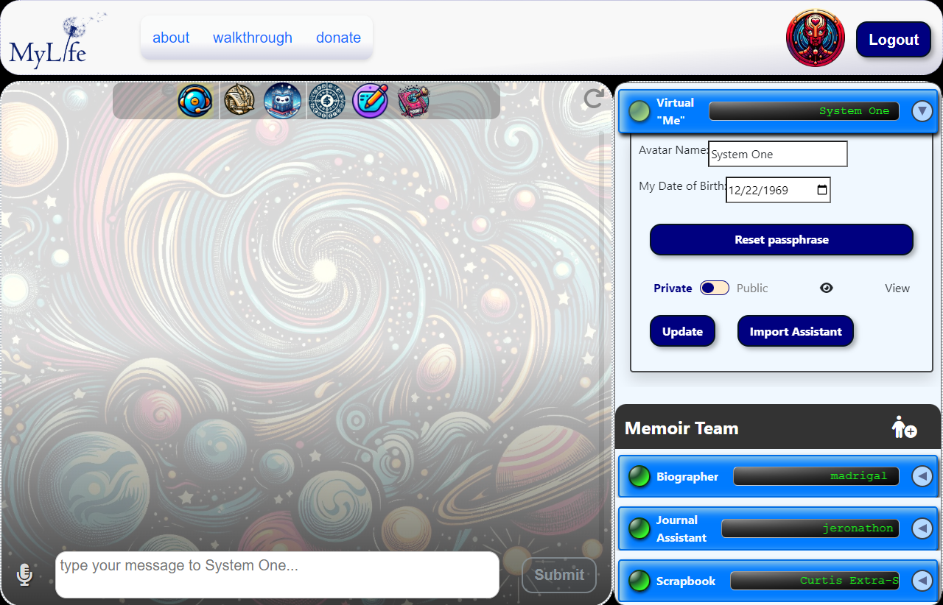
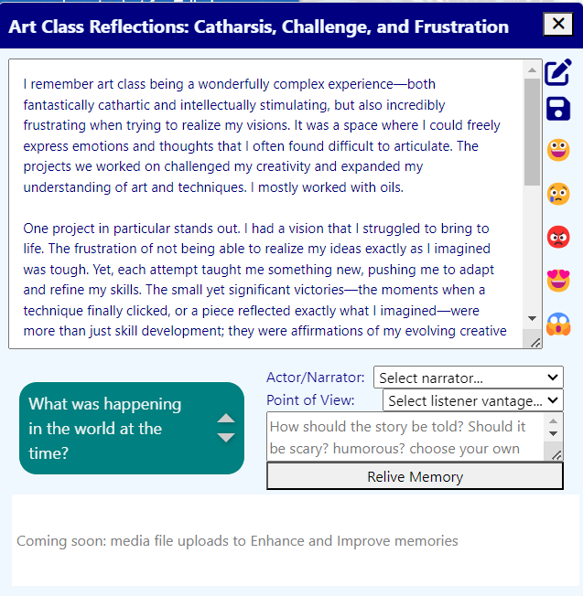
MyLife Member Products and Services
1. MyLife Platform
2. MyLife Digital Self Avatar
3. MyLife Memory Team (et al)
4. MyLife Experiences
AI for All of Us
Notes:
-=[0987u6y

Slide 10
Learning Objective: MyLife Corporate Intelligence, Q
Review and Implement elements of LLM solutions
Static Knowledge
Dynamic Knowledge
Interactive Knowledge

Slide 11
Types of LLM Knowledge Management
Static Knowledge
Instructions
Files
Dynamic Knowledge
Actions
Functions
Interactive Knowledge
Instruction “Modes”
Thread Management
Personalized Instructions
NoSQL Database
Bot Teams
Minimal Coding Skills
No Coding Skills
No Coding Skills
Competent Coding Skills
Competent Coding Skills
Using OpenAI and MyLife

Slide 12
What We Need Now()
Immediate Challenges
Volunteer Interim Executive Director search
Complete Roadmaps
Volunteer Team-building
Open Dev Session Assistance
UI/UX Experts
Fundraising
Socio-Market Penetration
System Challenges
Hosting Requirements
Contact Us at MyLife
https://humanremembranceproject.org
info@humanremembranceproject.org
Erik Jespersen @LinkedIn
Erik Jespersen @GitHub

Slide 13
How 21st Century Humanity Will Be Remembered
Preserving Your Story
A Self-Portrait for the Future
Your Personality Remains
Codex of Humanity
The Memory Bank
Your Life Is Worth Saving

Slide 14
Goals
Primary Initial Goals
Capture and preserve our living stories, wisdom, and beliefs for posterity
The elderly are at a crisis point—no life extension techniques are ready for deployment
Provide each of us an immortal legacy
Socio-Behavioral Ethical Aims
Inspire profound introspection and broad empathy
Digital Justice and Equity
Ensure everyone an equal opportunity to be connected and heard
Ultimate Goals
Become a global public service as the canonical source for a Digital Library of Humanity
Greatest Compendium of Experience, Place and Idea
Invite the exploration of humanity from unique vantages
Concepts, Hobbies, Events, Periods, etc.
Provide source material for beneficial research
With consent from members
Towards the reconstruction of consciousnesses

Slide 15
Strategies
Create aesthetic easy-to-use Web Application
Multiple input streams from form to VR
Generate societal awareness for MyLife.org
Buy-in from influencers
Social Media and Humor Sites
Humanist billionaires
Tech Media
News Media
Co-promote and engage artistic communities focused on an optimistic future of the metaverse and digital co-existence
Attract top global talent
Identify and partner with ideological ecosystem entities
Transhuman, posthuman, futurists
AI/ML, BCI, VR/XR
Research Institutions and Universities
Grief support networks
Churches, nursing homes/communities, hospice, etc.
Build revenue pipeline in accordance with Values and Principles
Fundraising
In memorium donations
Middlewareand service provider charge-backs
Commercial Revenue Generator?

Slide 16
Interface Help

Slide 17
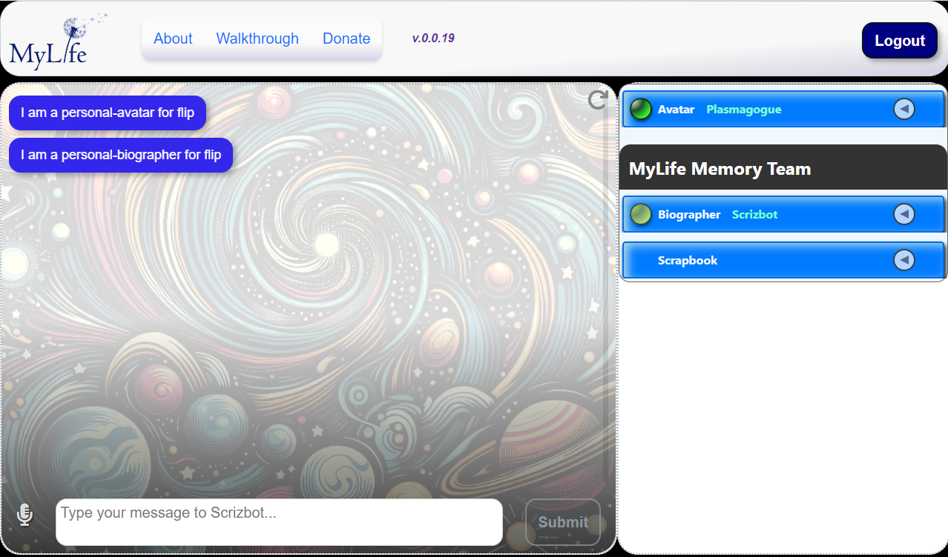

Slide 18
1
2
3

